Slide 1
STUDENT NAME:REVATHI R REGISTER NO:2213391036313/ FF30E863C1CD4BC96FA400500A282CA DEPARTMENT:BCOM GENERAL COLLEGE : Queen Mary’s College

Slide 2
PROJECT TITLE
Employee Performance Analysis
using Excel

Slide 3
AGENDA
Problem Statement
Project Overview
End Users
Our Solution and Proposition
Dataset Description
Modelling Approach
Results and Discussion
Conclusion

Slide 4
PROBLEM STATEMENT
Performance analysis are made to a employees. Increment to check the performance track of the employees and it is useful for the employees personal as well as organizational growth .So, the employees performance analysis helps to require all the problems and have a successful organization.

Slide 5
PROJECT OVERVIEW
Analysing the performance of the employees by considering the various factors like;
Gender,
Performance score and
Ratings.
Their involvement in work and various scores that analysis the performance of employees in the organisation.

Slide 6
WHO ARE THE END USER
HR business partner ,line manager , employees , senior, leadership , talent management team , analytics team , it department , training and development team

Slide 7
Our solution and its value proposition
Conditional formatting- missing values
filtering : remove missing data
Formulas : performance evaluation
Pivot :summary
Graph : data visualisation

Slide 8
Dataset description
EMPLOYEES DATABASE KIGGLE
There are 26 features but we consider 9 features employees ID numerical data
NAME TEXT
Performance level
Gender male or female
Employees rating numerical data

Slide 9
MODELLING
Data collection
Features collection
Data cleaning
Performance level
Summary
visualisation

Slide 10
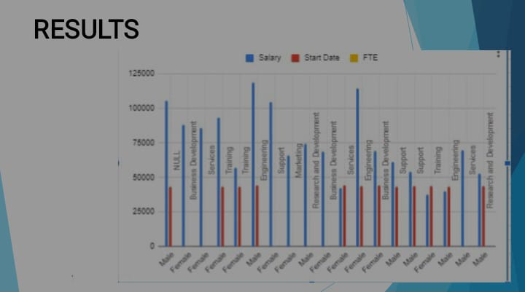
RESULT

Slide 11
CONCLUSION
WHILE COMPARING THE PERFORMANCE OF EMPLOYEES , THE NUMBER OF EMPLOYEES ARE HIGHER IN NUMBER IS IN THE AVERAGE PERFORMANCE WHERE EXCELLENCE EMPLOYEES ARE LESS IN PERCENTAGE . SO TO OVERCOME THIS WE SHOULD MOTIVATE THE EMPLOYEES BY GIVING THERE DIFFERENT TASKS BASED ON THEIR SKILLS TO IMPROVE THEIR PERFORMANCE IN THEIR WORK

Slide 12
THANKING YOU

